Slide 1
AUTOMATION PARKING SYSTEM
Progress Report
Week 4
YOLO v5 · Numberplate Detection · ESP32-S3 · PostgreSQL

Slide 2
Progress – Final Week
AUTOMATION PARKING SYSTEM
ESP32
Human sensor
Server
Database
Web

Slide 3
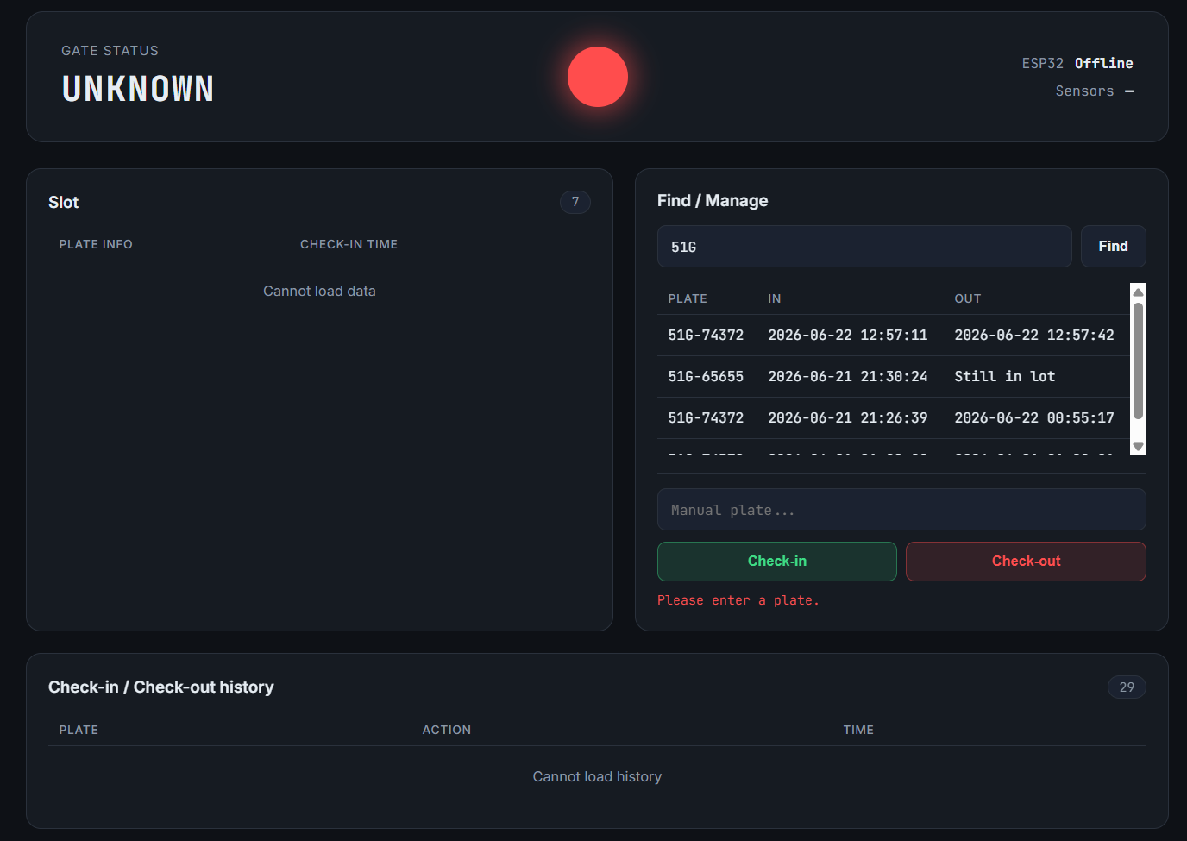
Finalized Project
01 / 02 · Progress – Week 3
Feature 1. Website for managing parking spot
System status
Occupied parking lot
Manual Management
Parking lot timeline

Slide 4
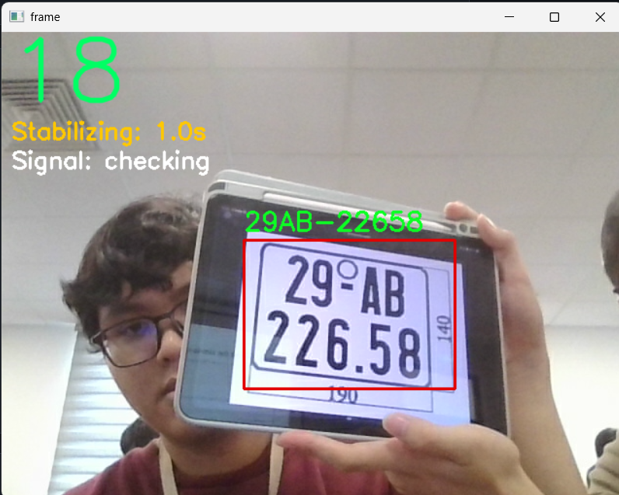
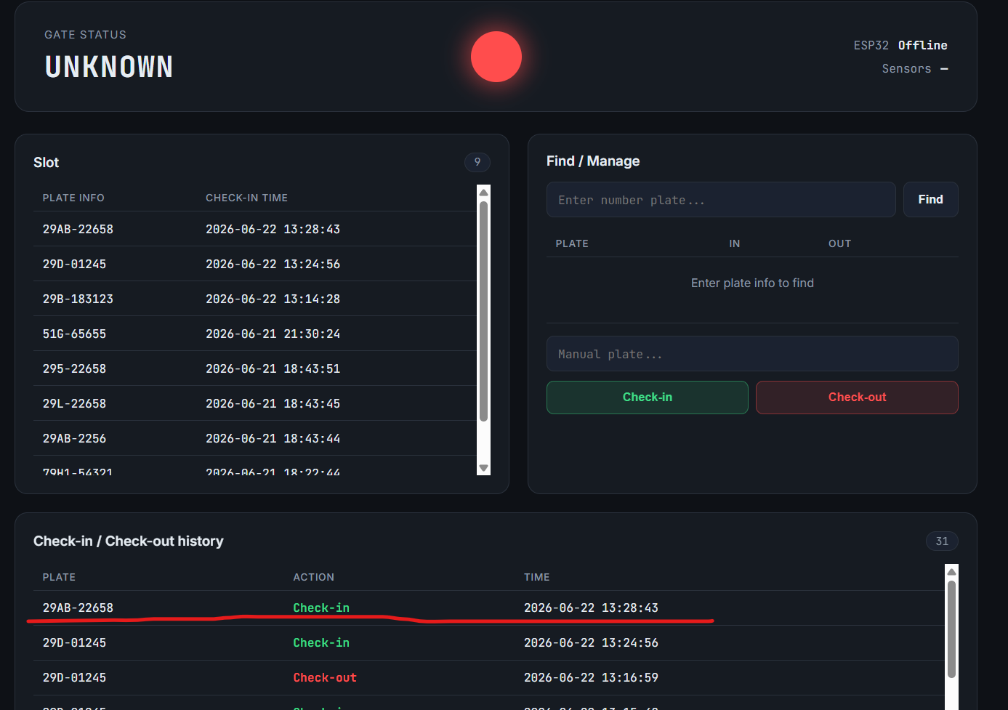
Finalized Project
02 / 02 · Progress – Week 3
Feature 2. Camera based automatic check-in system

Slide 5
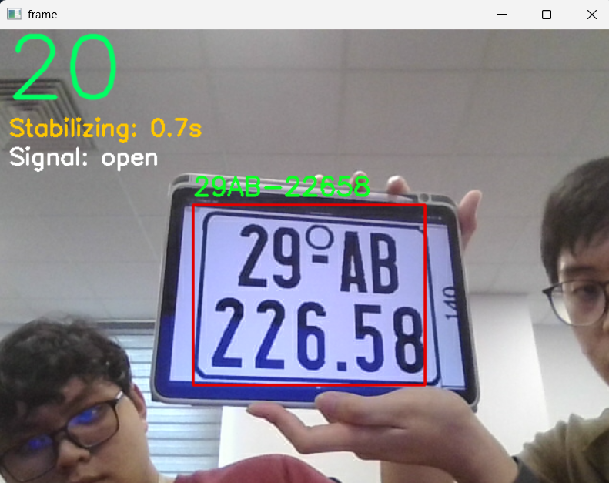
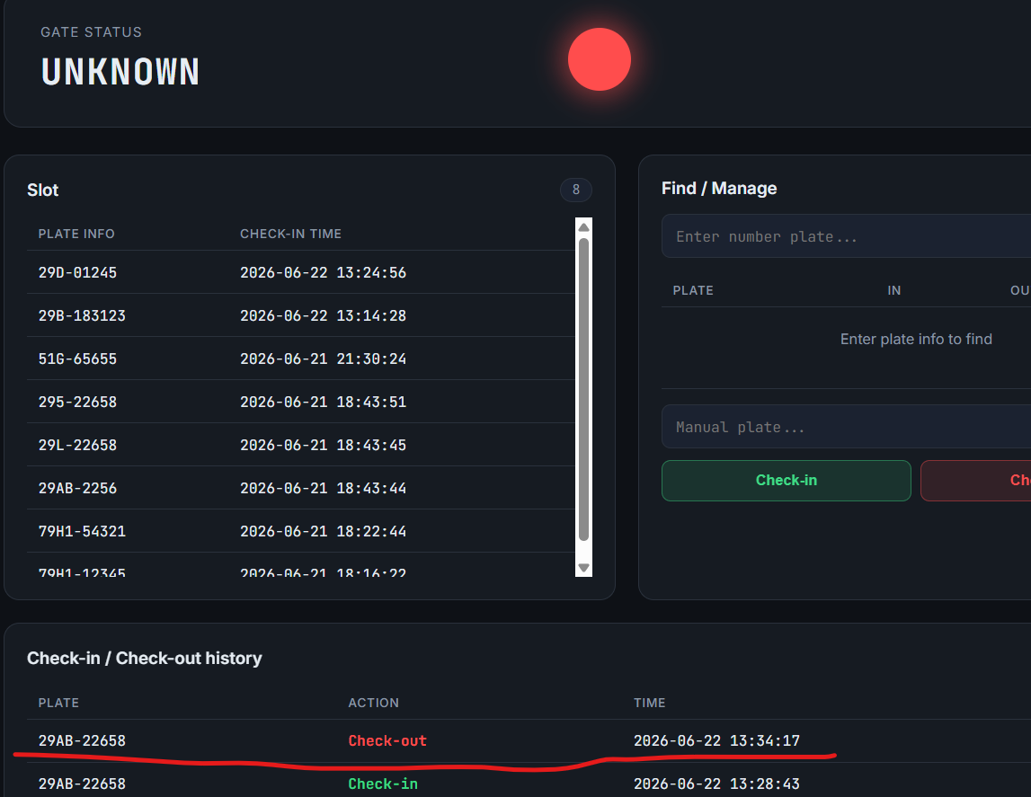
Finalized Project
02 / 02 · Progress – Week 3
Feature 3. Camera based automatic check-out system

Slide 6
Week 4
AUTOMATION PARKING SYSTEM
01
02
03
Optimizing Manual Management
Backend & Firmware Finalization
Connect all separated parts
Check list becomes more intuitive
Cleaning up messy coding logic, make the model more stable
Make web server and backend camera link up
Does not need manual copying to select a vehicle
Optimizing transition between parts
Cleaning up the site for more intuitivity
Preparing for future-proofing

Slide 7
Week 4
AUTOMATION PARKING SYSTEM
Requirement
Must install PostgreSQL Database in your computer and change the password as well as username same as your’s in ./dashboard/db.py
Python and libraries included in the ./requirements.txt

Slide 8
Thanks for your listening
AUTOMATION PARKING SYSTEM · PROGRESS REPORT · WEEK 3

